Slide 1
Implementation of Logic function Using Multiplexers
Sanjoy Kumar Chakravarty
Assistant Professor
CSE Dept., RU

Slide 2
Outline
Implementation of Logic function by different Multiplexer 2x1, 4x1, 8x1 etc. with the help of LUT (Look up table).
Implementation of Logic function by different Multiplexer 2x1, 4x1, 8x1 etc. with the help of Shannon Expansion theorem.

Slide 3
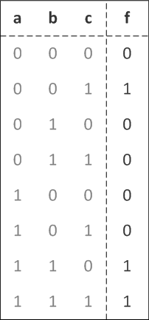
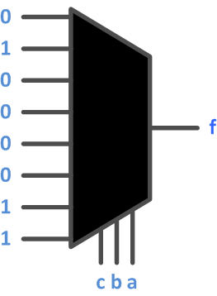
Implementation directly from truth tables
f(a, b, c) = a’b’c + ab

Slide 4
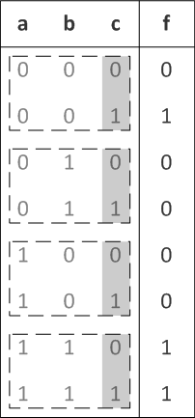
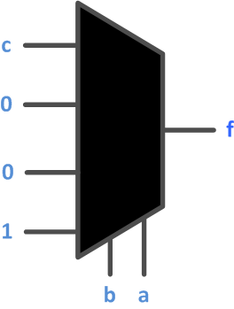
Implementation directly from truth tables
f(a, b, c) = a’b’c + ab for ( a , b ) = ( 0 , 0 ) → f = c
for ( a , b ) = ( 0 , 1 ) → f = 0
for ( a , b ) = ( 1 , 0 ) → f = 0
for ( a , b ) = ( 1, 1 ) → f = 1

Slide 5
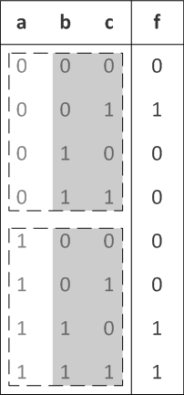
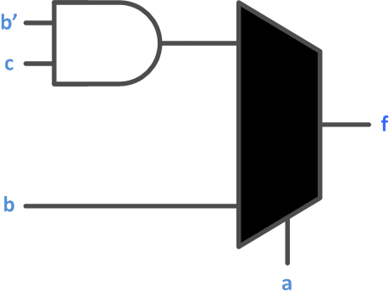
Implementation directly from truth tables
f(a, b, c) = a’b’c + ab for a == 0 → f = b’ . c
for a == 1 → f = ( b . c’ ) + ( b . c ) = b

Slide 6
Implementation of a logic function with a 4x1 multiplexer
w
w
f
w
2
1
2
w
1
0
0
0
0
0
1
1
1
1
0
1
1
f
1
1
0
0

Slide 7
Implementation of the same logic function with a 2x1 multiplexer
w
1
w
2
f
w
f
1
w
0
0
0
w
1
0
2
0
1
1
w
w
1
2
2
1
0
1
f
1
1
0
(b) Modified truth table
(c) Circuit

Slide 8
Implementation of another logic function
w
1
w
2
w
3
f
0
0
0
0
0
0
1
0
0
1
0
0
0
1
1
1
1
0
0
0
1
0
1
1
1
1
0
1
1
1
1
1

Slide 9
Implementation of another logic function
w
1
w
2
w
3
f
w
1
w
2
f
0
0
0
0
0
0
0
1
0
0
0
0
1
w
3
0
1
0
0
1
0
w
3
0
1
1
1
1
1
1
1
0
0
0
1
0
1
1
1
1
0
1
1
1
1
1

Slide 10
Implementation of another logic function
w
1
w
2
w
3
f
w
1
w
2
f
0
0
0
0
0
0
0
1
0
0
0
0
1
w
3
0
1
0
0
1
0
w
3
0
1
1
1
1
1
1
1
0
0
0
1
0
1
1
1
1
0
1
1
1
1
1
(a) Modified truth table
w
2
w
1
0
w
3
f
1
(b) Circuit

Slide 11
Implementation of another logic function
w
1
w
2
w
3
f
0
0
0
0
0
0
1
0
0
1
0
0
0
1
1
1
1
0
0
0
1
0
1
1
1
1
0
1
1
1
1
1

Slide 12
Implementation of another logic function
w
1
w
2
w
3
f
w
1
w
2
f
0
0
0
0
0
0
0
1
0
0
0
0
1
w
3
0
1
0
0
1
0
w
3
0
1
1
1
1
1
1
1
0
0
0
1
0
1
1
1
1
0
1
1
1
1
1
[ Figure 4.7a from the textbook ]

Slide 13
Implementation of another logic function
w
1
w
2
w
3
f
w
1
w
2
f
0
0
0
0
0
0
0
1
0
0
0
0
1
w
3
0
1
0
0
1
0
w
3
0
1
1
1
1
1
1
1
0
0
0
1
0
1
1
1
1
0
1
1
1
1
1
(a) Modified truth table
w
2
w
1
0
w
3
f
1
(b) Circuit

Slide 14
Another Example (3-input XOR)

Slide 15
Implementation of 3-input XOR with 2-to-1 Multiplexers
w
w
w
f
1
2
3
0
0
0
0
0
0
1
1
0
1
0
1
0
1
1
0
1
0
0
1
1
0
1
0
1
1
0
0
1
1
1
1

Slide 16
Implementation of 3-input XOR with 2-to-1 Multiplexers
w
w
w
f
1
2
3
0
0
0
0
0
0
1
1
w
⊕
w
0
1
0
1
2
3
0
1
1
0
1
0
0
1
1
0
1
0
w
⊕
w
1
1
0
0
2
3
1
1
1
1
[ Figure 4.8a from the textbook ]

Slide 17
Implementation of 3-input XOR with 2-to-1 Multiplexers
w
w
w
f
1
2
3
0
0
0
0
0
0
1
1
w
⊕
w
w
0
1
0
1
2
3
2
w
1
0
1
1
0
w
3
1
0
0
1
f
1
0
1
0
w
⊕
w
1
1
0
0
2
3
1
1
1
1
(a) Truth table
(b) Circuit

Slide 18
Implementation of 3-input XOR with a 4-to-1 Multiplexer
w
1
w
2
w
3
f
0
0
0
0
0
0
1
1
0
1
0
1
0
1
1
0
1
0
0
1
1
0
1
0
1
1
0
0
1
1
1
1

Slide 19
Implementation of 3-input XOR with a 4-to-1 Multiplexer
w
1
w
2
w
3
f
0
0
0
0
w
0
0
1
1
3
0
1
0
1
w
0
1
1
0
3
1
0
0
1
w
1
0
1
0
3
1
1
0
0
w
1
1
1
1
3
[ Figure 4.9a from the textbook ]

Slide 20
Implementation of 3-input XOR with a 4-to-1 Multiplexer
w
1
w
2
w
3
f
0
0
0
0
w
0
0
1
1
3
w
2
w
1
0
1
0
1
w
0
1
1
0
3
w
3
1
0
0
1
w
f
1
0
1
0
3
1
1
0
0
w
1
1
1
1
3
(a) Truth table
(b) Circuit

Slide 21
Multiplexor Synthesis Using Shannon’s Expansion

Slide 22
Three-input majority function
w
1
w
2
w
3
f
0
0
0
0
0
0
1
0
0
1
0
0
0
1
1
1
1
0
0
0
1
0
1
1
1
1
0
1
1
1
1
1

Slide 23
Three-input majority function
w
1
w
2
w
3
f
0
0
0
0
w
1
f
0
0
1
0
0
0
1
0
0
1
0
1
1
1
1
0
0
0
1
0
1
1
1
1
0
1
1
1
1
1

Slide 24
Three-input majority function
w
1
w
2
w
3
f
0
0
0
0
w
1
f
0
0
1
0
w
w
0
2
3
0
1
0
0
1
w
+
w
0
1
1
1
2
3
1
0
0
0
1
0
1
1
1
1
0
1
1
1
1
1

Slide 25
Three-input majority function
w
1
w
2
w
3
f
0
0
0
0
w
1
f
0
0
1
0
w
w
0
2
3
0
1
0
0
1
w
+
w
0
1
1
1
2
3
1
0
0
0
1
0
1
1
1
1
0
1
1
1
1
1
(b) Truth table
w
w
1
2
w
3
f
(b) Circuit

Slide 26

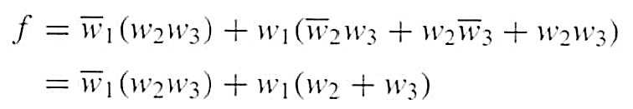
Three-input majority function
w
w
1
2
w
3
f

Slide 27

Shannon’s Expansion Theorem
Any Boolean function can be rewritten in the form:

Slide 28

Shannon’s Expansion Theorem
Any Boolean function can be rewritten in the form:

Slide 29
Shannon’s Expansion Theorem
Any Boolean function can be rewritten in the form:
cofactor
cofactor

Slide 30
Shannon’s Expansion Theorem
Shannon’s expansion assumes a switching algebra system
Divide a switching function into smaller functions
Pick a variable x, partition the switching function into two cases: x=0 and x=1
f(x)=xf(1)+x’f(0)
f(x,y)=xf(1,y)+x’f(0,y)
f(x,y,z,…)=xf(1,y,z,…)+x’f(0,y,z,…)

Slide 31
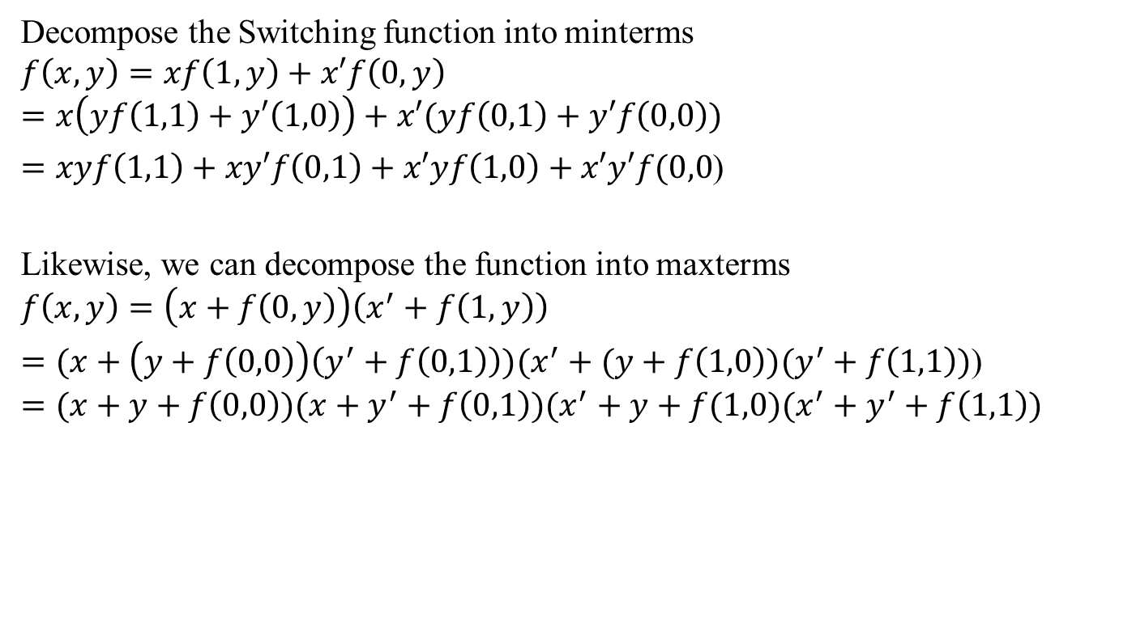
Shannon’s Expansion Theorem

Slide 32
Shannon’s Expansion Theorem
(Example)

Slide 33
Shannon’s Expansion Theorem
(Example)
(w₁ + w₁)

Slide 34
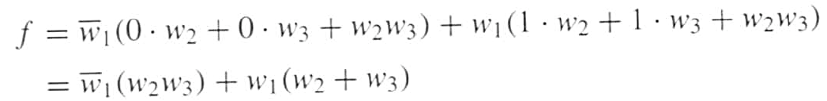
Shannon’s Expansion Theorem
(Example)
(w₁ + w₁)
This form is suitable for implementation with a 2x1 multiplexer.

Slide 35
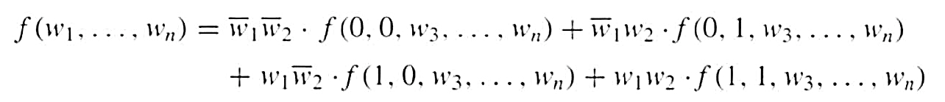
Shannon’s Expansion Theorem
(In terms of more than one variable)
This form is suitable for implementation with a 4x1 multiplexer.

Slide 36
Another Example

Slide 37

Factor and implement the following function with a 2x1 multiplexer

Slide 38
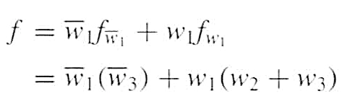
Factor and implement the following function with a 2x1 multiplexer

Slide 39
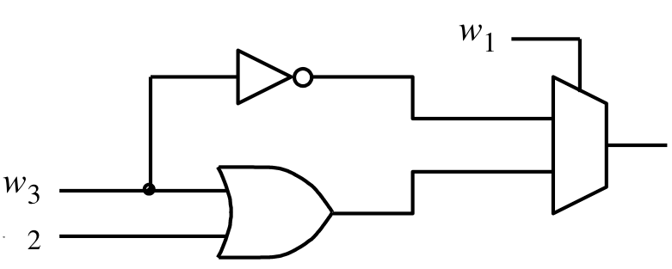
Factor and implement the following function with a 2x1 multiplexer
f
w

Slide 40
Factor and implement the following function with a 4x1 multiplexer

Slide 41
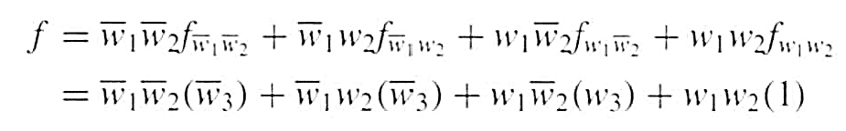
Factor and implement the following function with a 4x1 multiplexer

Slide 42
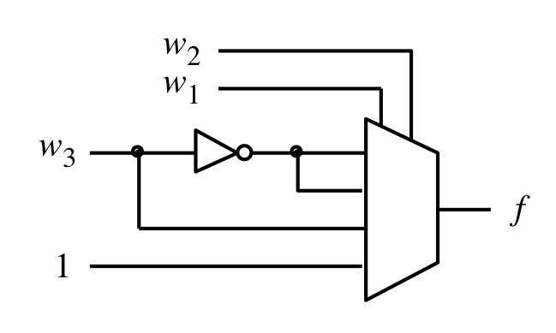
Factor and implement the following function with a 4x1 multiplexer

Slide 43
Yet Another Example

Slide 44

Factor and implement the following function using only 2x1 multiplexers

Slide 45
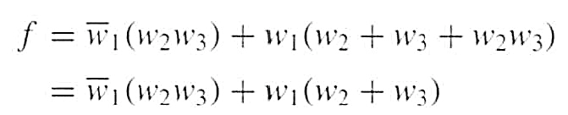
Factor and implement the following function using only 2x1 multiplexers

Slide 46


Factor and implement the following function using only 2x1 multiplexers

Slide 47
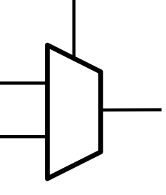


Factor and implement the following function using only 2x1 multiplexers
w₁
g
f
h

Slide 48


Factor and implement the following function using only 2x1 multiplexers

Slide 49


Factor and implement the following function using only 2x1 multiplexers

Slide 50
Factor and implement the following function using only 2x1 multiplexers
w₂
w₂
0
w₃
g
h
w₃
1

Slide 51
Finally, we are ready to draw the circuit
w₂
0
w₁
g
w₃
g
f
w₂
h
w₃
h
1

Slide 52
Finally, we are ready to draw the circuit
w₂
0
g
w₁
w₃
f
1
h

Slide 53
Finally, we are ready to draw the circuit
w
w
2
1
0
w
3
f
1

Slide 54
Assignment
Design a 1-bit full adder using 4x1 Mux.

Slide 55
THE END

